Slide 1
Chapter 4:
Project Integration Management
Information Technology Project Management
Note: See the text itself for full citations.

Slide 2

Project Integration Management
Project Integration
PMBOK -­‐ Edition 5

Slide 3
What is project integration management?
Project integration management involves coordinating all elements of a project, including tasks, resources, stakeholders, and deliverables.
The purpose of project integration management is to ensure that processes run efficiently and meet predefined goals.

Slide 4
Strategic Planning
Strategic planning involves determining long-term objectives, predicting future trends, and projecting the need for new products and services
Organizations often perform a SWOT analysis
  analyzing Strengths, Weaknesses, Opportunities, and Threats
Notes:
As part of strategic planning, organizations
identify potential projects
use realistic methods to select which projects to work on
formalize project initiation by issuing a project charter

Slide 5
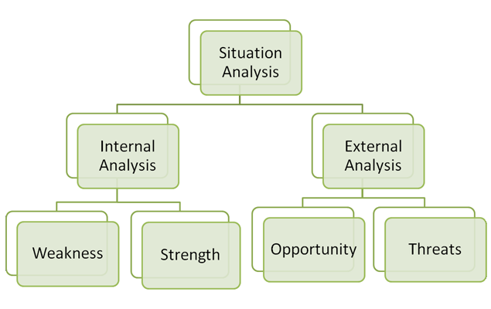
Analyse Internal & External Environment

Slide 6
SWOT Analysis for Mobile App Development
Strengths
Innovative Idea
Weaknesses
Development Costs
Team Skills
Academic Support
Learning Opportunity
Lack of Experience
Technical Issues
Resource Limitations
Notes:
Strengths (Internal Positive Factors)
Innovative Idea: Your app may solve a unique problem or address a niche audience.
Low-Cost Development: As a student project, you may have access to free or discounted tools, software, and resources (e.g., GitHub Student Developer Pack, free tiers of cloud services).
Team Skills: If your team has members with complementary skills (e.g., coding, design, marketing), this can be a significant advantage.
Academic Support: Access to mentors, professors, or university resources for guidance and feedback.
Flexibility: As a student project, you have the freedom to experiment and iterate without the pressure of commercial deadlines.
Learning Opportunity: The project allows you to gain hands-on experience in app development, which can enhance your resume and portfolio.
Weaknesses (Internal Negative Factors)
Limited Budget: As students, you may have limited financial resources for advanced tools, marketing, or hosting.
Time Constraints: Balancing the project with academic workload and other commitments can be challenging.
Lack of Experience: Limited real-world experience in app development may lead to technical challenges or inefficiencies.
Scope Creep: Overambitious features or unclear goals can make the project difficult to complete within the given timeframe.
Resource Limitations: Limited access to high-end devices for testing or advanced software licenses.
Opportunities (External Positive Factors)
Growing Mobile Market: The increasing use of smartphones creates a vast potential user base for your app.
University Ecosystem: You can target fellow students or university-related problems, creating a built-in audience for testing and feedback.
Competitions and Grants: Many universities and organizations offer funding, competitions, or hackathons for student projects.
Networking: Collaborating with peers, professors, or industry professionals can open doors for future opportunities.
Open-Source Tools: Leveraging free or open-source frameworks and libraries can reduce development time and cost.
Portfolio Building: A successful app can serve as a portfolio piece for internships, jobs, or further academic pursuits.
Threats (External Negative Factors)
Competition: The app market is highly saturated, making it difficult to stand out.
Technical Challenges: Compatibility issues across different devices, operating systems, or updates can arise.
User Retention: Even if the app is launched, retaining users can be difficult without continuous updates and engagement.
Intellectual Property Issues: Risk of someone copying your idea or facing legal challenges if you use copyrighted material.
Time Constraints: External deadlines (e.g., semester end) may limit the time available for development and refinement.
Market Changes: Rapid changes in technology or user preferences could make your app obsolete quickly.

Slide 7
SWOT Analysis for Mobile App Development
Opportunities
Growing Mobile Market
Weaknesses
Competition
Competitions and Grants
Open-Source Tools
Partnerships
Intellectual Property Issues
App Store Policies
Market Changes
Notes:
Strengths (Internal Positive Factors)
Innovative Idea: Your app may solve a unique problem or address a niche audience.
Low-Cost Development: As a student project, you may have access to free or discounted tools, software, and resources (e.g., GitHub Student Developer Pack, free tiers of cloud services).
Team Skills: If your team has members with complementary skills (e.g., coding, design, marketing), this can be a significant advantage.
Academic Support: Access to mentors, professors, or university resources for guidance and feedback.
Flexibility: As a student project, you have the freedom to experiment and iterate without the pressure of commercial deadlines.
Learning Opportunity: The project allows you to gain hands-on experience in app development, which can enhance your resume and portfolio.
Weaknesses (Internal Negative Factors)
Limited Budget: As students, you may have limited financial resources for advanced tools, marketing, or hosting.
Time Constraints: Balancing the project with academic workload and other commitments can be challenging.
Lack of Experience: Limited real-world experience in app development may lead to technical challenges or inefficiencies.
Scope Creep: Overambitious features or unclear goals can make the project difficult to complete within the given timeframe.
Resource Limitations: Limited access to high-end devices for testing or advanced software licenses.
Opportunities (External Positive Factors)
Growing Mobile Market: The increasing use of smartphones creates a vast potential user base for your app.
University Ecosystem: You can target fellow students or university-related problems, creating a built-in audience for testing and feedback.
Competitions and Grants: Many universities and organizations offer funding, competitions, or hackathons for student projects.
Networking: Collaborating with peers, professors, or industry professionals can open doors for future opportunities.
Open-Source Tools: Leveraging free or open-source frameworks and libraries can reduce development time and cost.
Portfolio Building: A successful app can serve as a portfolio piece for internships, jobs, or further academic pursuits.
Threats (External Negative Factors)
Competition: The app market is highly saturated, making it difficult to stand out.
Technical Challenges: Compatibility issues across different devices, operating systems, or updates can arise.
User Retention: Even if the app is launched, retaining users can be difficult without continuous updates and engagement.
Intellectual Property Issues: Risk of someone copying your idea or facing legal challenges if you use copyrighted material.
Time Constraints: External deadlines (e.g., semester end) may limit the time available for development and refinement.
Market Changes: Rapid changes in technology or user preferences could make your app obsolete quickly.

Slide 8
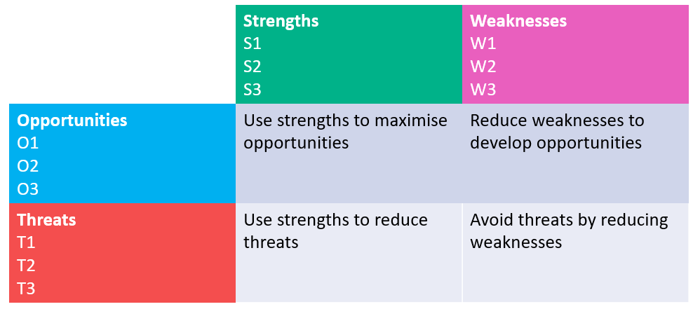
TOWS Matrix

Slide 9
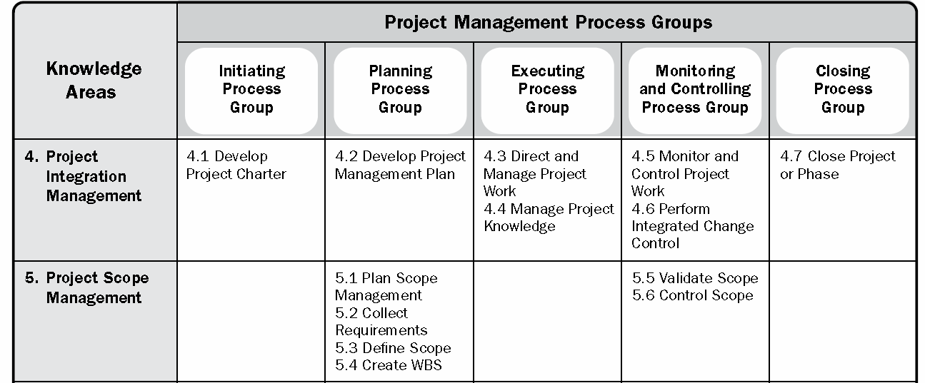
Project Management Process Groups and Knowledge Areas Mapping
https://youtu.be/SvCB_TbydHA

Slide 10
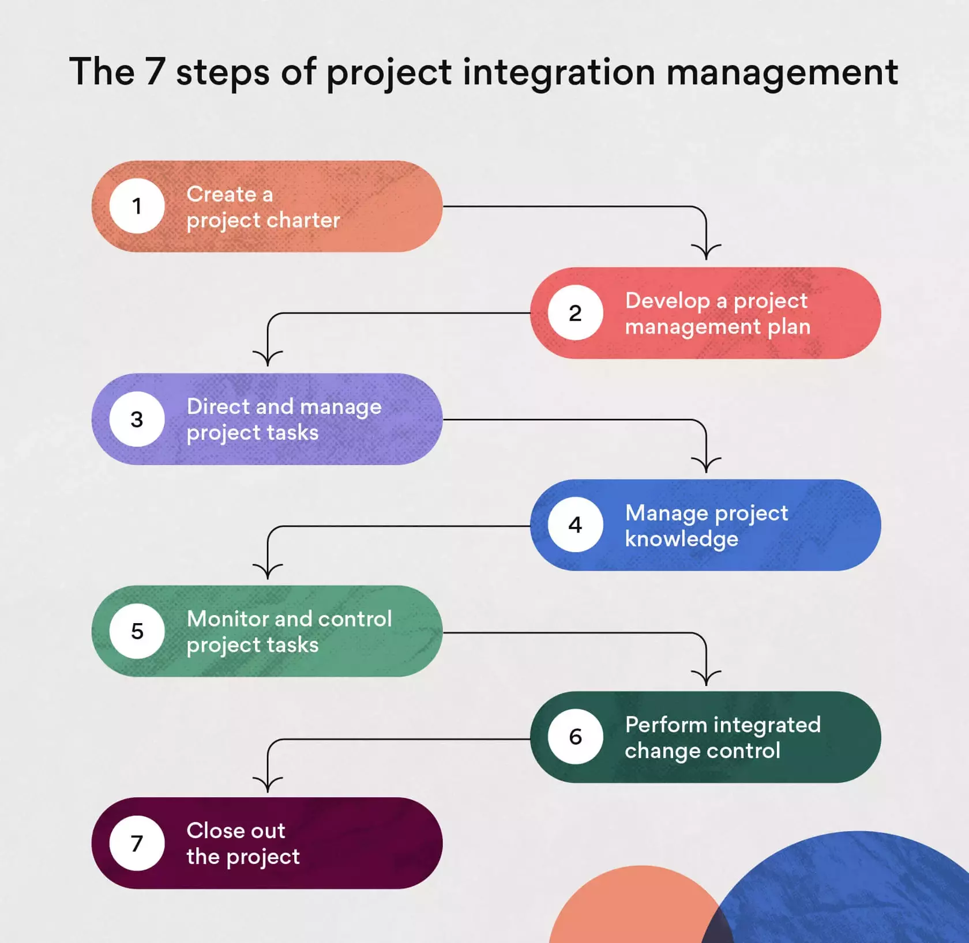

Slide 11
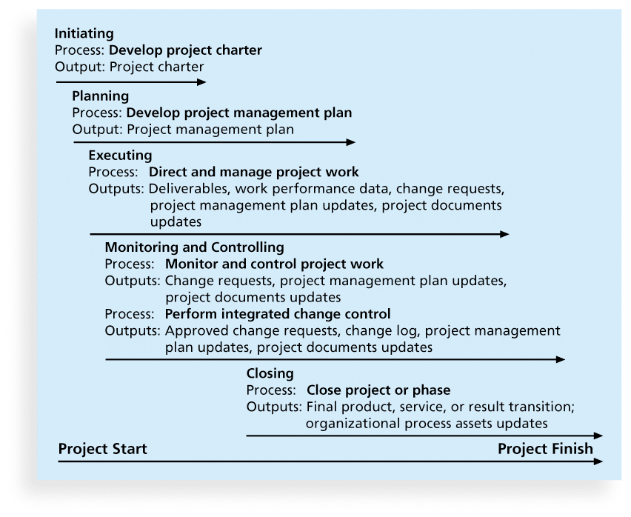
Figure 4-1. Project Integration Management Summary

Slide 12
4.1- Develop Project Charter
A project charter is a document that defines the objectives, scope, and stakeholders of a project, providing a roadmap for the team to follow.
Output: Project charter
Notes:
Project

Slide 13
Steps to writing a Project Charter
Choose a Project Name
Identify the Purpose, Objective, and Project Specification
Set a Budget
Define Deliverables
Assess Scope and Risks
Create a Timeframe or Milestones
List Key Stakeholders
Layout Team Roles and Responsibilities

Slide 14
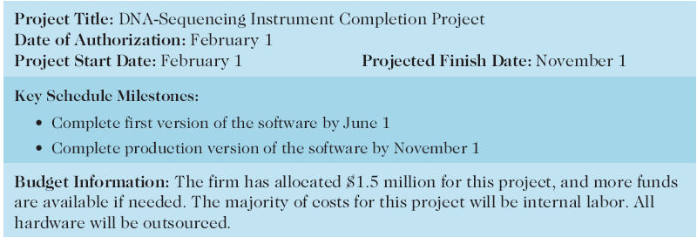
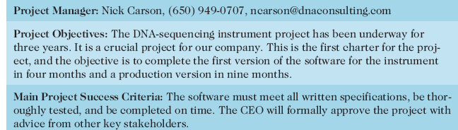
Table 4-1. Project Charter for the DNA-Sequencing Instrument Completion Project

Slide 15
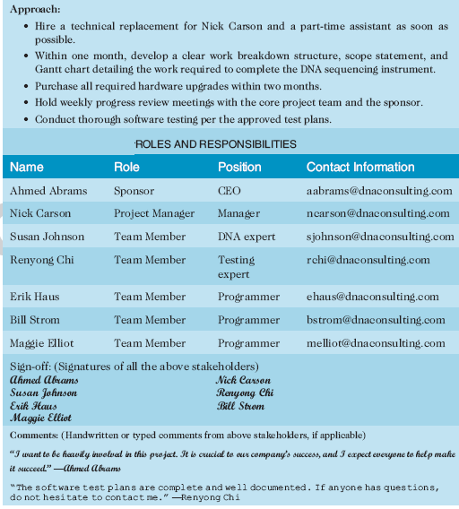
Table 4-1. Project Charter (cont.)

Slide 16
4.2- Develop a Project Management Plan
Process of defining, preparing, and coordinating all subsidiary plans and integrating them into a comprehensive project management plan.
Output
  Project management plan

Slide 17
4.3- Directing and Managing Project Work
Process of leading and performing the work defined in the project management plan and implementing approved changes to achieve the project’s objectives.
Outputs.
  Deliverables.
  Work performance data
  Issue log
  Change requests

Slide 18
4.4- Manage Project Knowledge
The process of using existing knowledge and creating new knowledge to support organizational operations and future projects or phases.
Outputs
  Lessons learned register
  Project management plan updates

Slide 19
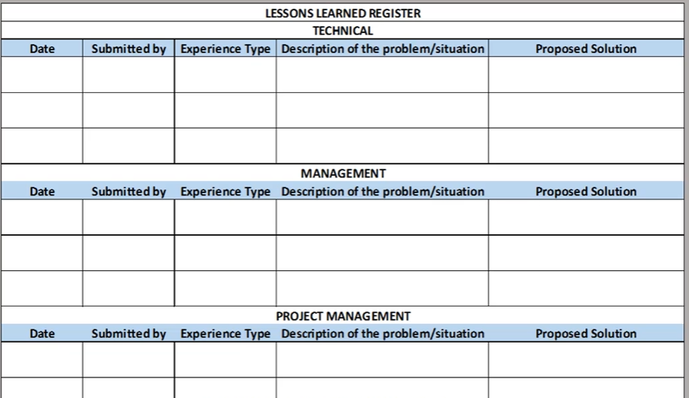
Manage Project Knowledge

Slide 20
4.5 - Monitor & Control Project Work
The process of tracking, reviewing, and reporting the progress to meet the performance objectives defined in the project management plan.
Outputs
  Work performance reports
  Change requests
  Project management plan updates
  Project documents update

Slide 21
4.6- Perform Integrated Change Control
Reviewing all change requests; Approving/Rejecting changes.
Outputs:
  Approved change requests
  Project management plan updates
  Project documents update

Slide 22
4.7- Closing Projects or Phases
To close a project or phase, you must finalize all activities and transfer the completed or cancelled work to the appropriate people.
The outputs of closing projects are as follows:
  Project documents updates
  Final product, service, or result
  Final report
Notes:
Main outputs include
Final product, service, or result transition
Organizational process asset updates

Slide 23
Chapter Summary
Project integration management involves coordinating all of the other knowledge areas throughout a project’s life cycle
Main processes include
  Develop the project charter
  Develop the project management plan
  Direct and manage project execution
  Monitor and control project work
  Perform integrated change control
  Close the project or phase

Slide 24
Questions
What is project integration management, and why is it essential for project success?
List three processes involved in project integration management

